Slide 1
MIS 422 Weekly Assignment 3
Zachariah Cooper & Kellyn Elaine Wolden

Slide 2
Purpose
CO2 Emissions
Relationship with Size
Investigate and compare emissions around the world
Look into the potential relationship of
Population
GDP
to CO2 emissions

Slide 3
Transformations
Parse Data
Deletions
Merge Country Data w/ Emissions Data
Create a column containing only country names
Remove any excess characters
Remove any irrelevant data
i.e. G7 emissions
Matched data on country name
Used Left Join to keep all emissions data even if no GDP data

Slide 4
Interesting Findings

Slide 5
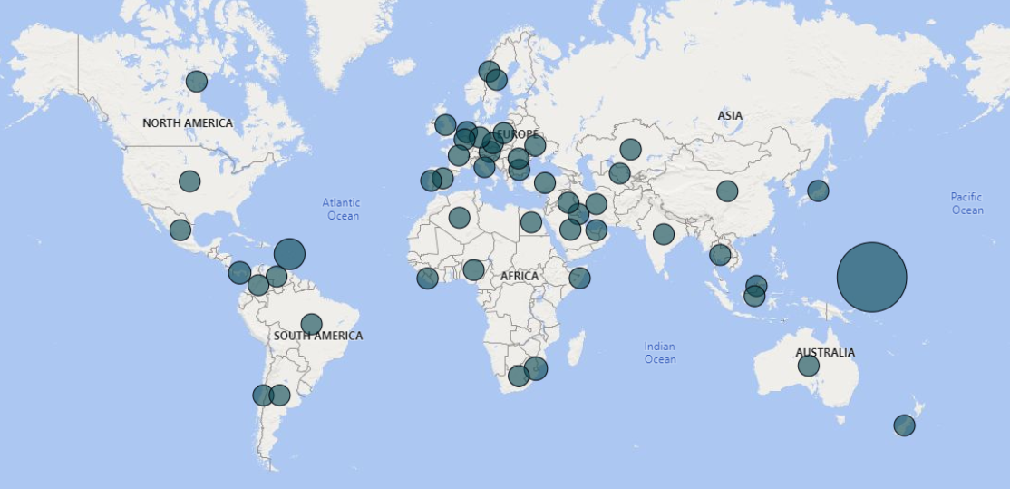
Population
Countries like Micronesia had small populations, so they had less emissions per person than other top emitting countries.

Slide 6
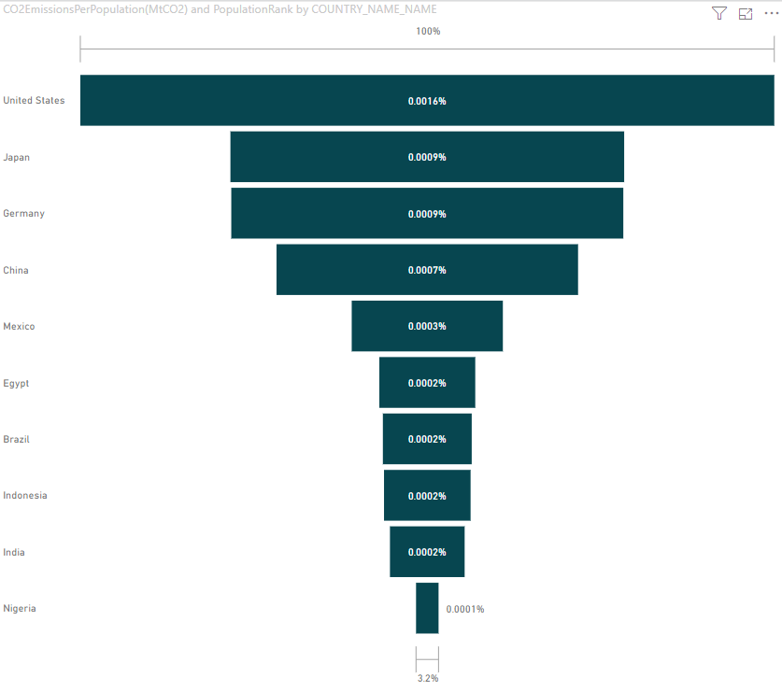
Largest
India, while one of the largest CO2 emitters, is able to keep their emissions per population down more significantly than countries like Mexico.

Slide 7
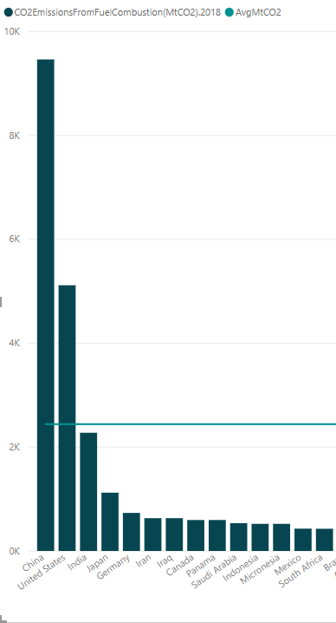
Average
Of our calculated average, only two countries are exceeding that value: China and the United States.

